Slide 1
Section 11.2 Series
Lecture 3
Divergence Test and Harmonic Series

Slide 2
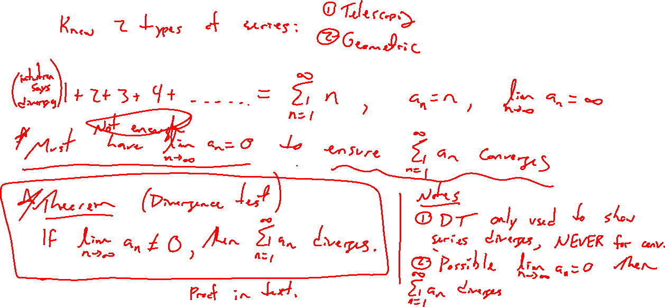
Divergence Test
Notes:
Given a general series, does it converge or not? Know the answer for special cases (telescoping / geometric)
Example: 1+2+3+4+5+… for sure cannot be finite. Need a_n \rightarrow 0.
Theorem statement.
Note, the divergence test does not say anything about convergence, only divergence.
Is a_n \rightarrow 0 enough for convergence? Answer ends up being no.

Slide 3
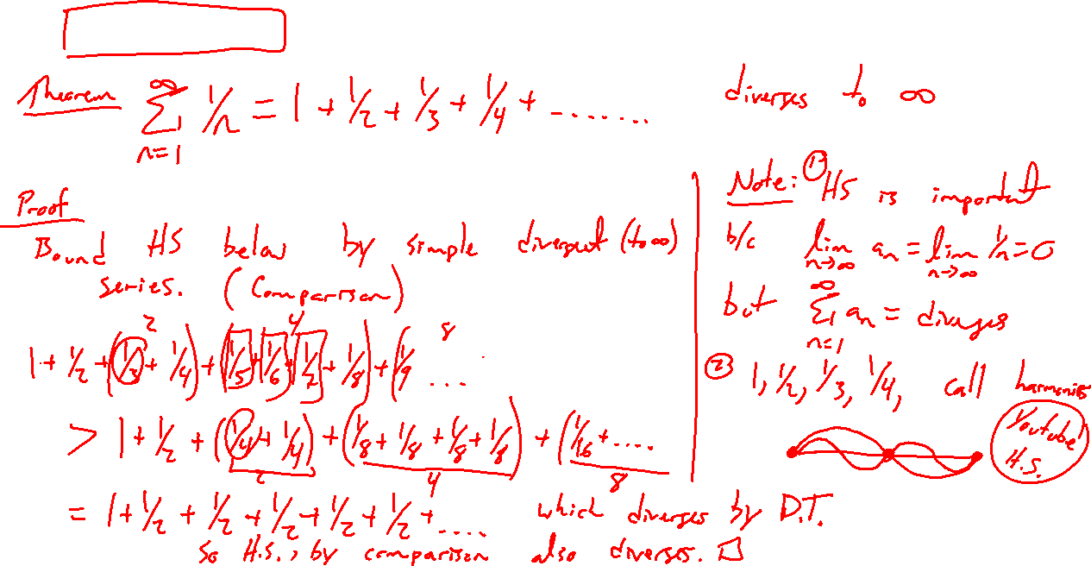
Harmonic Series
Notes:
1+½+1/3+¼+….
Argue diverges by bounding below: 1+½+(1/3+¼)+(1/5+….+1/8)+… > 1+½+(¼+¼)+(1/8+…+1/8)+… = 1+½+½+½+… diverges by div test

Slide 4
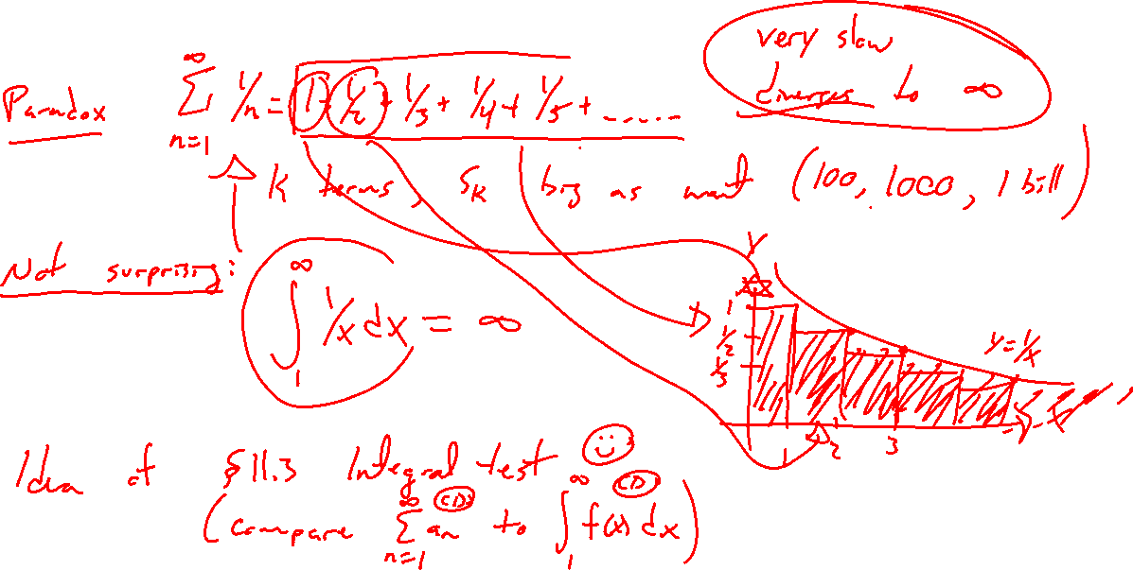
Harmonic Series Intuition
Notes:
1+½+1/3+… is an important example of divergent series since a_n \rightarrow 0 (rate of decay matters)
Compare to \int_1^{\infty} 1/x dx which we already know. Draw picture. This leads to integral test in next section.
Growth of HS is extremely slow, but it does grow without bound.
Desmos demonstration
https://mathworld.wolfram.com/HarmonicSeries.html

Slide 5
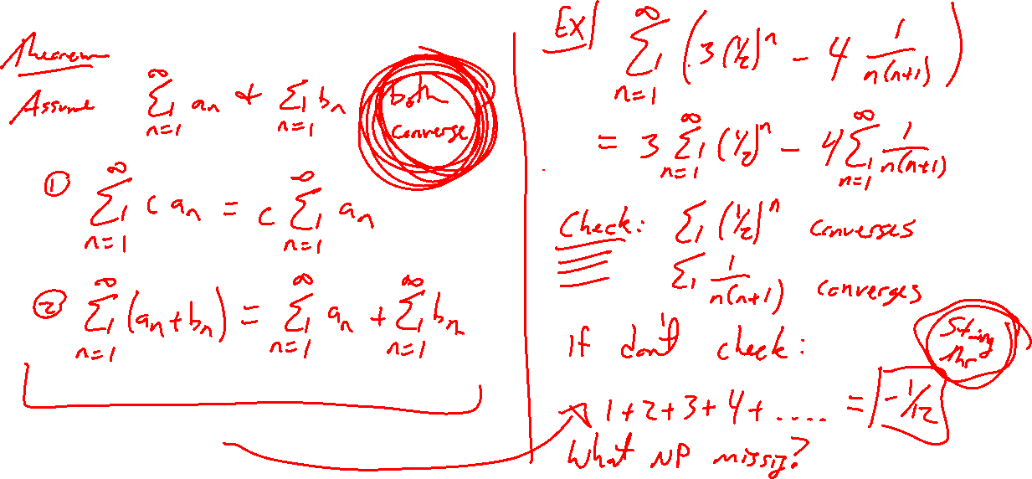
Series Theorems
Notes:
If both converge, separate addition and factor out constants
Example: sum (½)^n – 5(¼)^n
Beware if break basic laws of series: Numberphile 1+2+3+…=-1/12 (Where did they go wrong?)

Slide 6

Section 11.2 Examples and Exercises
Rework examples 1, 3, 4, 6, 8, 10, 11. Steps:
Write down problem
Attempt on own
Check / improve your answer against the text solution
Exercises 15, 17, 23, 29, 31, 45

Slide 7

Section 11.2 Homework Submission to Canvas
Preview of section​
Skim section, write short paragraph summary, list all important definitions / theorems / formulas.​
Notes on video lectures​
Include all details, worked examples, your own thoughts​
Worked examples from text​
Solutions to exercises​
Final reflection of section​
List of key takeaways to remember​

